Slide 1

Bayesian Optimization
Team 열려라 참깨

Slide 2
INDEX
What is Bayesian Optimization?
Black-box function
Bayesian Optimization
Surrogate Model
Acquisition Function
Limitation
Reference
Q & A

Slide 3
1. What is Bayesian Optimization?
- One way to optimize hyperparameters.
- X : bounded domain
- f(x) : black-box function

Slide 4
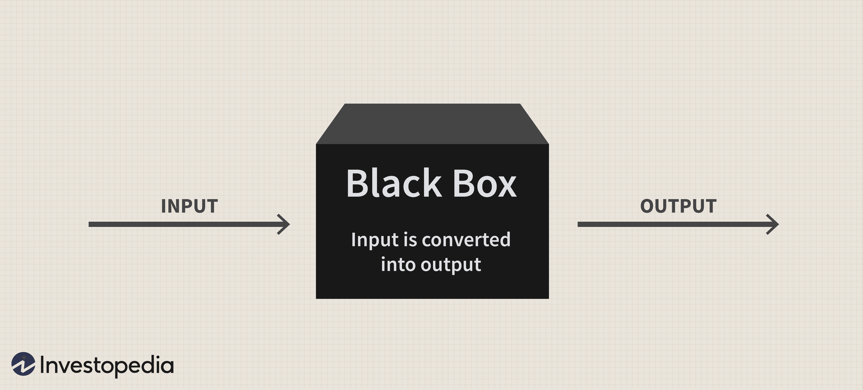
2. Black-box function

Slide 5
3. Bayesian Optimization – (1)
This method works in three steps.
Using the observed data D = [(x₁, f(x₁)), (x₂, f(x₂)), ...] so far, we estimate f(x) using some method. => Surrogate Model
To predict f(x) more precisely, the next observation point (x_{n+1}, f(x_{n+1})) is selected through a decision rule. => Acquisition function
Add the obtained (x_{t}, f(x_{t})) to D, return to 1 and repeat until the stopping criteria are reached.

Slide 6
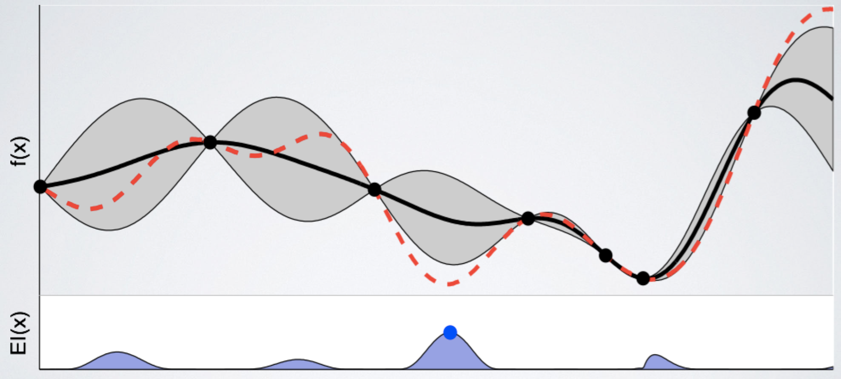
3. Bayesian Optimization – (2)
--- : black box function f(x)
: estimated function f’(x)
: Confidence bound that f(x) exists
EI(x) : acquisition function

Slide 7
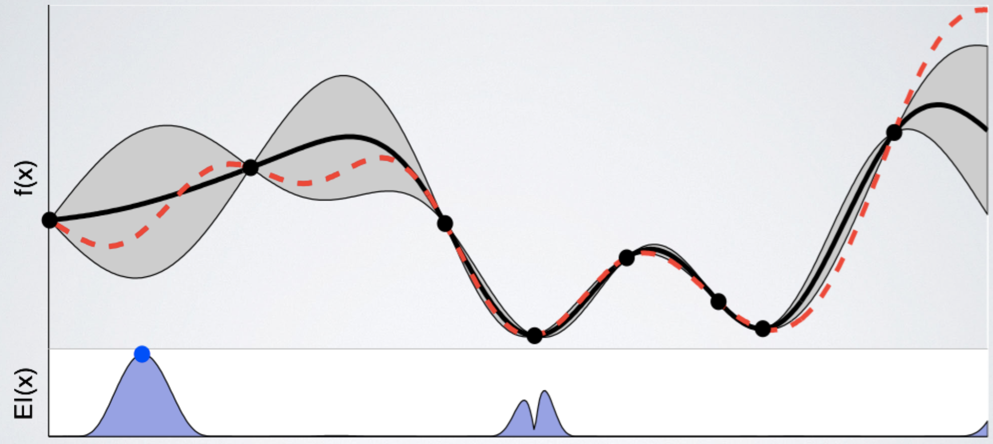
3. Bayesian Optimization – (3)
--- : black box function f(x)
: estimated function f’(x)
: Confidence bound that f(x) exists
EI(x) : acquisition function

Slide 8
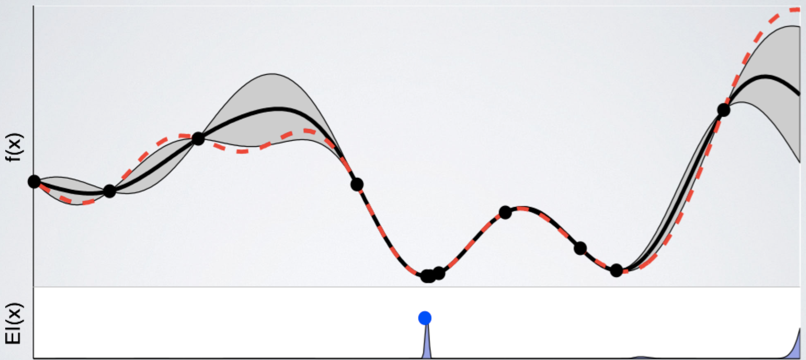
3. Bayesian Optimization – (4)
--- : black box function f(x)
: estimated function f’(x)
: Confidence bound that f(x) exists
EI(x) : acquisition function

Slide 9
4. Surrogate Model
Various models can be used, and the most used probabilistic model is the Gaussian Process.
Gaussian Process is defined by two functions: mean function and kernel function.

Slide 10
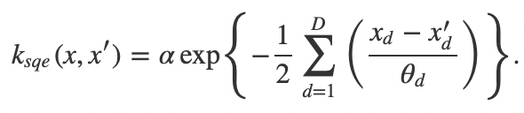
4-1. Gaussian Process
Mean function
> Usually, the mean value is chosen, but zero-mean is also used.
Kernel function: A function that defines what kind of relationship the given samples have with each other.
x_{d} : value of dimension d
α, θ_{d} : hyper-parameter

Slide 11
5. Acquisition Function – (1)
There are various functions, Expected Improvement (EI) is the most used.
EI appropriately includes both Exploitation and Exploration.
> Exploitation : Re-irradiation into the vicinity of the investigated values.
> Exploration : Investigate the section with the highest uncertainty.

Slide 12
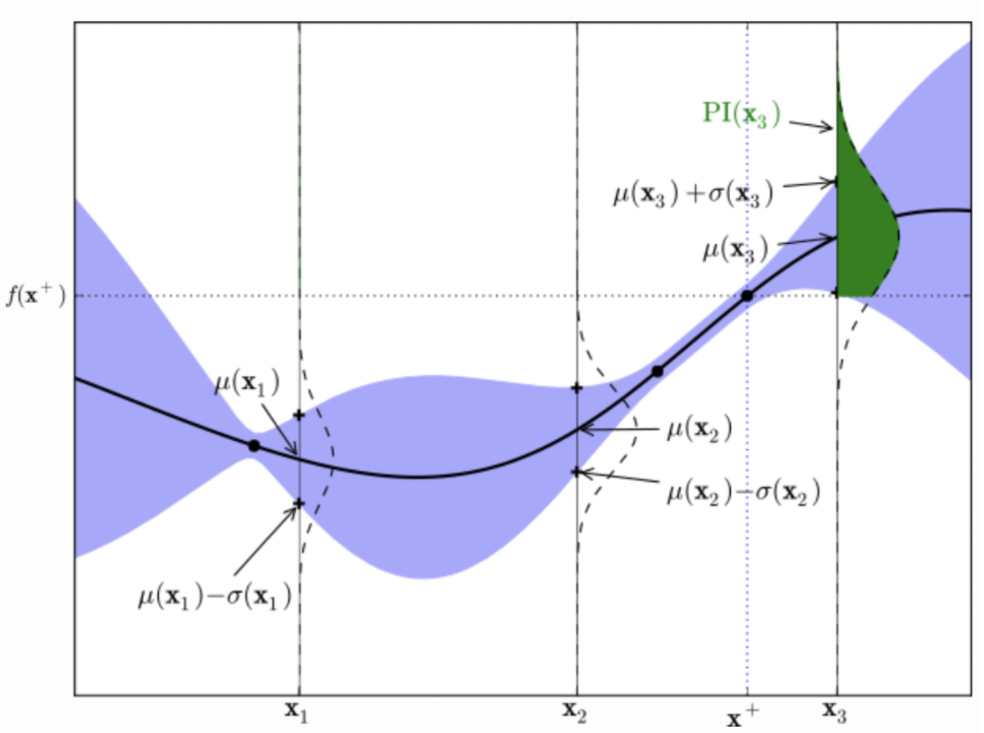
5. Acquisition Function – (2)

Slide 13
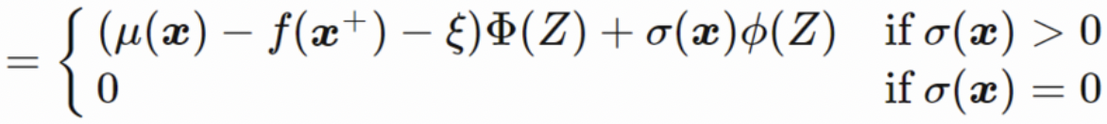
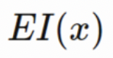
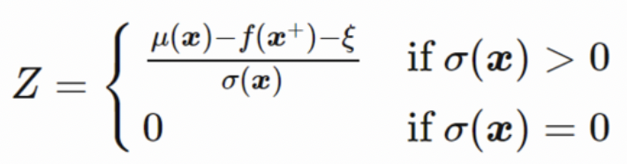
5. Acquisition Function – (3)
parameter for
exploration and exploitation

Slide 14
6. Limitation – (1)
To use BO, GP hyperparameters must be tuned (kernel function parameters, etc.)
Unlike grid search or random search, parallelization is impossible because the process of finding the next point using the acquisition function is sequential.

Slide 15
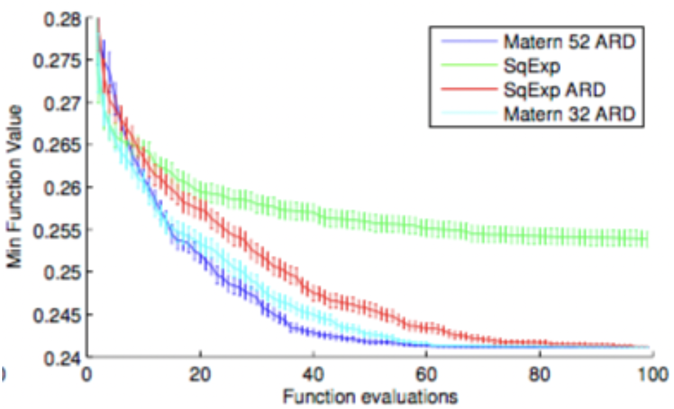
6. Limitation – (2)
Practical Bayesian Optimization of Machine learning
https://papers.nips.cc/paper/2012/file/05311655a15b75fab86956663e1819cd-Paper.pdf

Slide 16
7. Reference
Practical Bayesian Optimization of Machine Learning Algorithms (NIPS 2012). SanghuchChun. 2016. http://sanghyukchun.github.io/99/
Bayesian Optimization. Mutex. 2019. https://blog.naver.com/PostView.nhn?blogId=dpfkdlt&logNo=221678800067&from=search&redirect=Log&widgetTypeCall=true&directAccess=false
Optimization : Bayesian Optimization. Kokirimambo. 2020. https://mambo-coding-note.tistory.com/284

Slide 17
Q & A

